Slide 1
Chapter 9
VE216 RC6

Slide 2
Eigenfunctions & Eigenvalues
Eigenfunctions & Eigenvalues
  the output is a scaled version of its input
  input: Eigenfunctions
  scaling factor: Eigenvalues

Slide 3

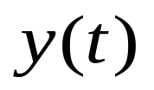

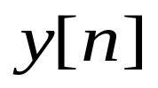
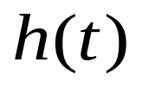

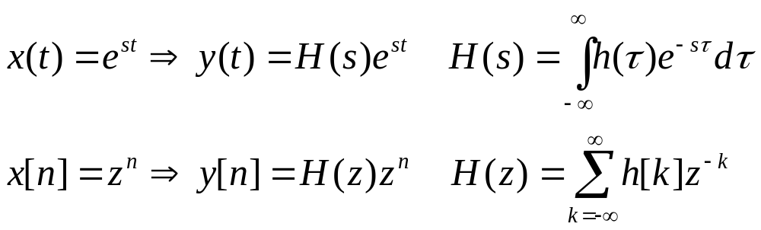
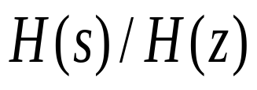
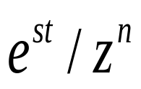
Eigenfunctions & Eigenvalues
transfer function/eigenvalue
eigenfunction

Slide 4
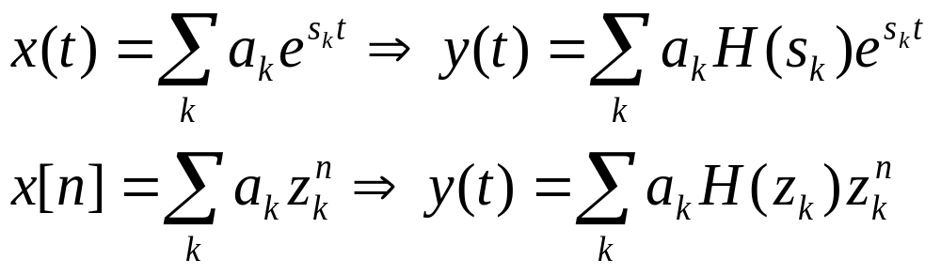

Superposition Principle for LTI System
are complex numbers

Slide 5
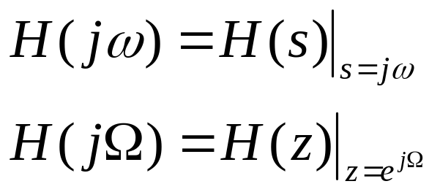
Fourier Analysis
H(s): Laplace transform of h(t)
H(z): z-transform of h[n]
Frequency Response of the system:
fourier transform of h(t)
fourier transform of h[n]

Slide 6
Laplace Transform
Definition
Region of Convergence
Property Table
Pair Table
Inverse Laplace Transform
Transfer function & System function
Unilateral LT

Slide 7
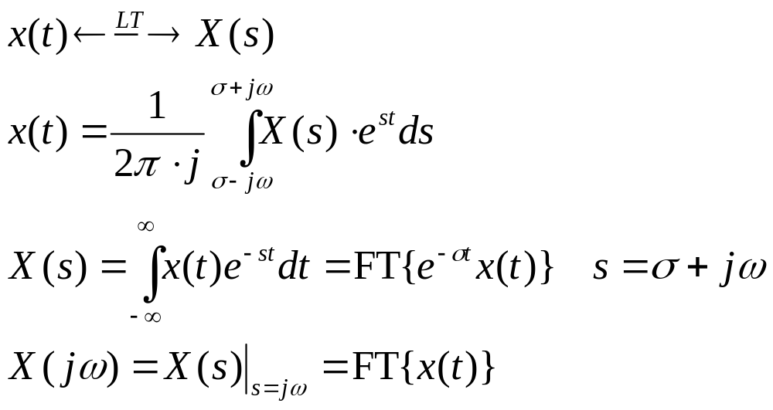
Definition of LT
For a continuous signal x(t)

Slide 8

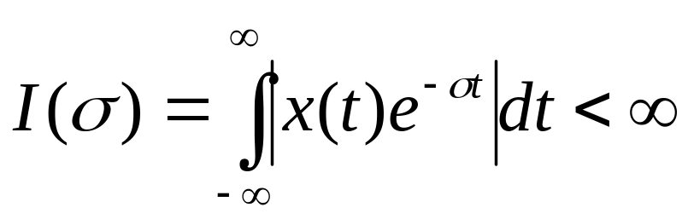
Region of Convergence
ROC: The range of for which LT convergence
ROC plot in s-plane

Slide 9
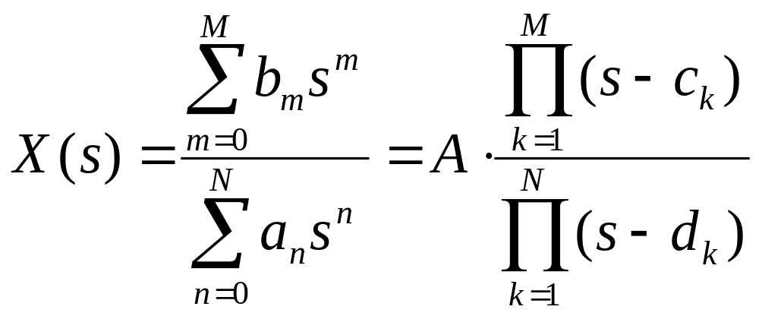
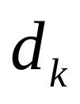
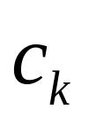
Poles & Zeros
Pole:
Zero:
Pole-Zero Plot

Slide 10
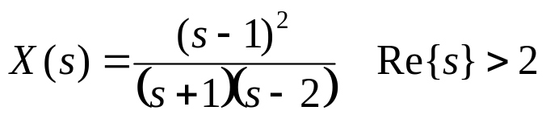
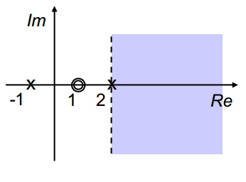
Plot in s-plane

Slide 11
Property of ROC
The ROC consists of strips parallel to the jw-axis in the s-plane
For rational Laplace transforms, the ROC does not contain any poles
If x(t) is of finite duration and is absolutely integrable, then the ROC is the entire s-plane

Slide 12
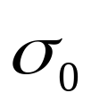

Property of ROC
If x(t) is right-sided, and if the line Re{s}= is in the ROC, then all values of s for which Re{s}> will also be in the ROC
If x(t) is left-sided, and if the line Re{s}= is in the ROC, then all values of s for which Re{s}< will also be in the ROC
If x(t) is two sided, and if the line Re{s}= is in the ROC, then the ROC will consist of a strip in the s-plane that includes the line Re{s}=

Slide 13
Property of ROC
For rational Laplace transform, the ROC is bounded by poles or extends to infinity
For rational Laplace transform, the ROC of a right-sided signal is the region in the s-plane to the right of the rightmost pole
For rational Laplace transform, the ROC of a left-sided signal is the region in the s-plane to the left of the leftmost pole
If ROC includes jw-axis, FT of x(t) exists

Slide 14
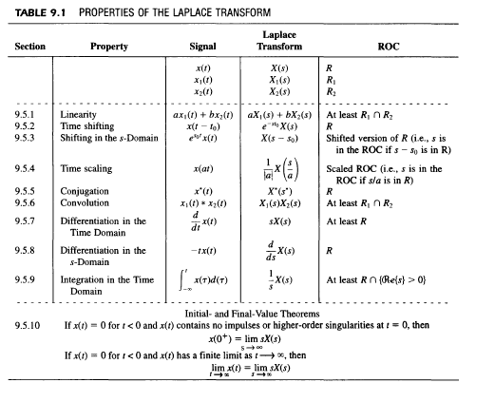
Property Table
Watch out for ROC

Slide 15
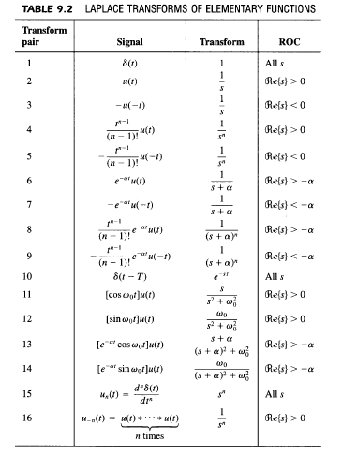
Pair Table
Watch out for ROC

Slide 16
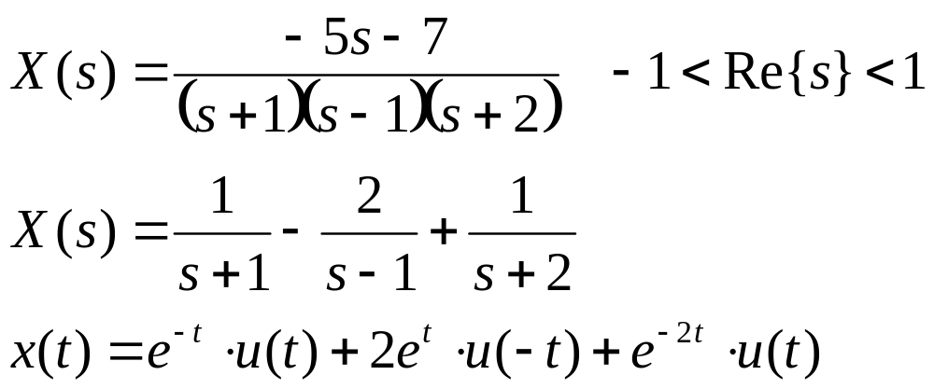
Inverse Laplace Transform
Ex 1:

Slide 17
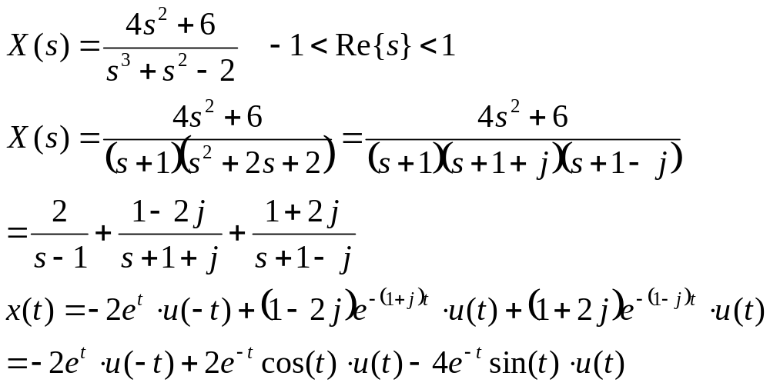
Inverse Laplace Transform
Ex 2:

Slide 18
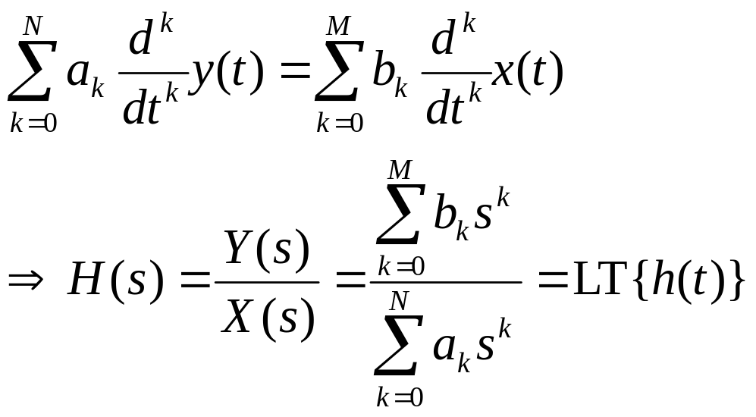
Transfer Function H(s)
For a LTI system
H(s): transfer function of the LTI system

Slide 19
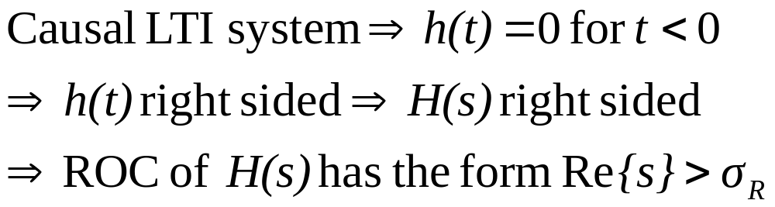
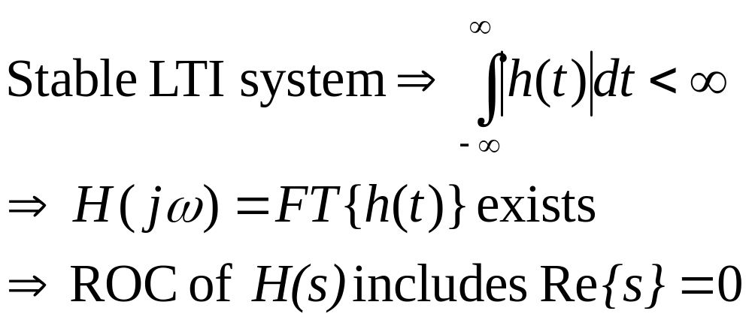
H(s) & Properties of LTI system
Causality
Stability

Slide 20
H(s) & Properties of LTI system
Both causal & stable
  All poles of H(s) lies in the left-half of the s-plane

Slide 21
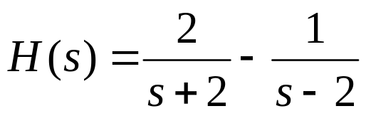
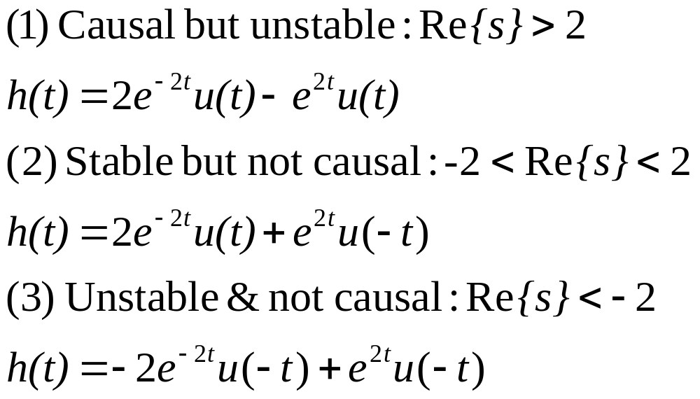
H(s) & Properties of LTI system
Ex 3:
  find h(t), the impulse response of the system

Slide 22
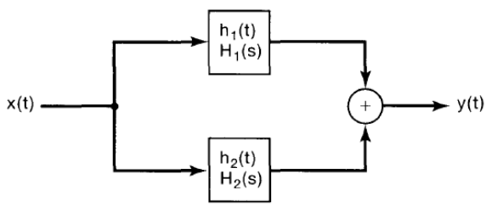
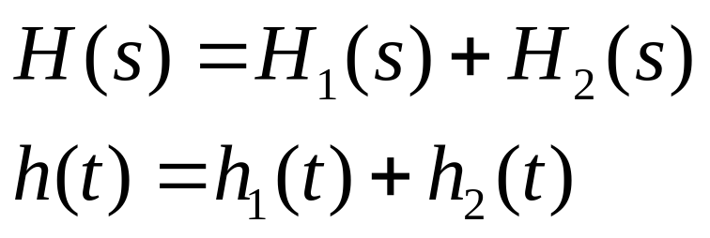
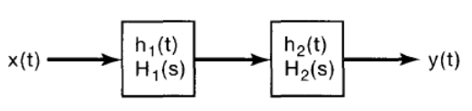
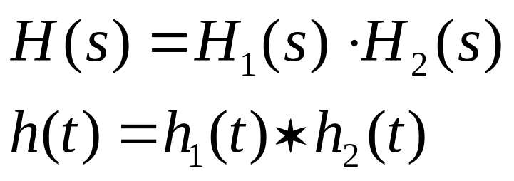
System function
Parallel system
Cascade System

Slide 23
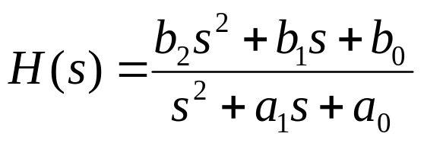
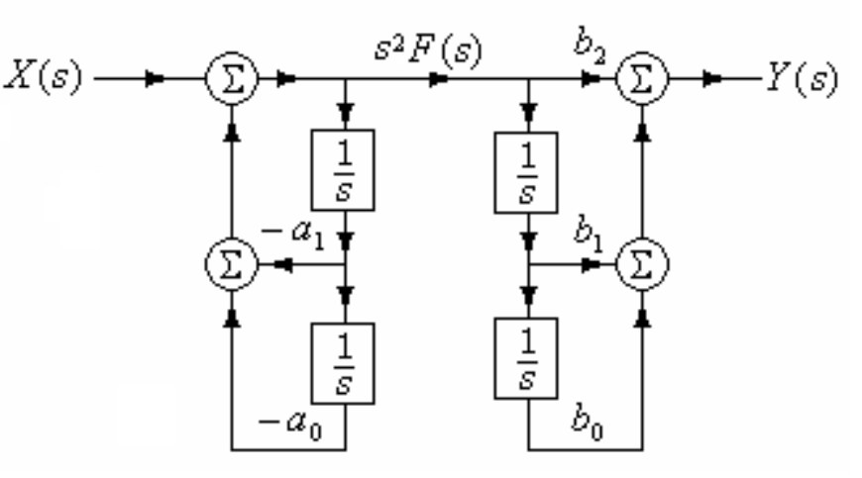
Block Diagram Representation

Slide 24
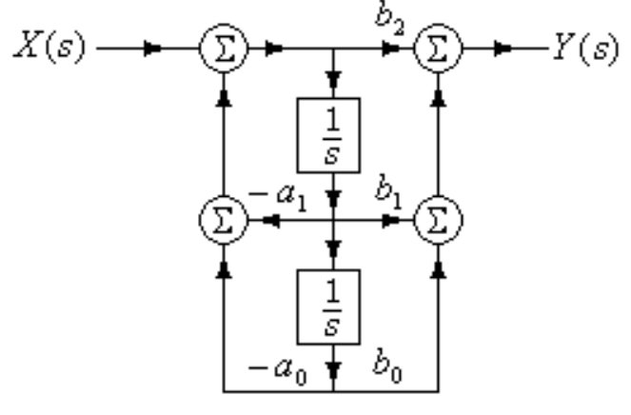
Block Diagram Representation

Slide 25
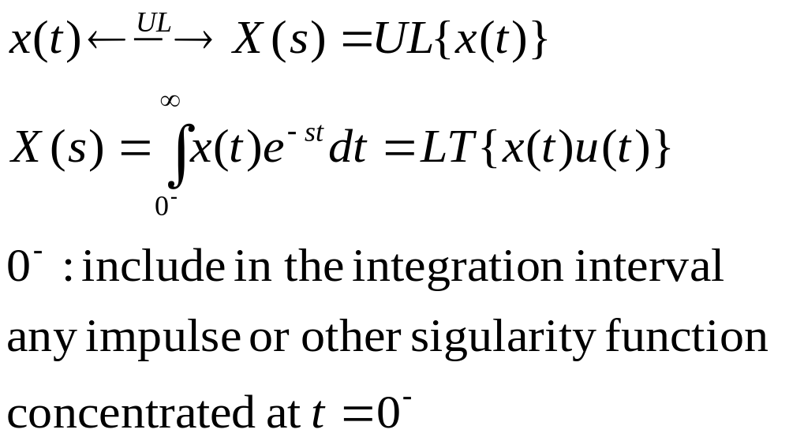
Unilateral LT
Unilateral/One-sided LT

Slide 26
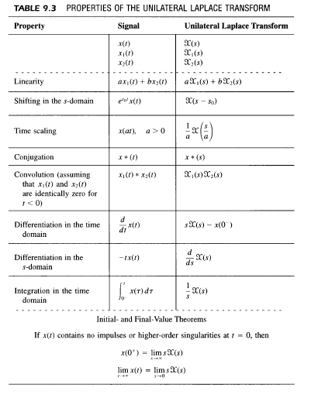
Property of Unilateral LT
Main Application: causal systems specified by linear constant coefficient differential equations with nonzero initial conditions
The ROC for a unilateral Laplace transform must always be a right-half plane
Any signal that is identically zero for t<0 has identical bilateral and unilateral Laplace transforms

Slide 27
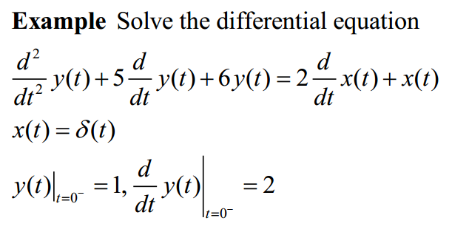
Application of Unilateral LT

Slide 28
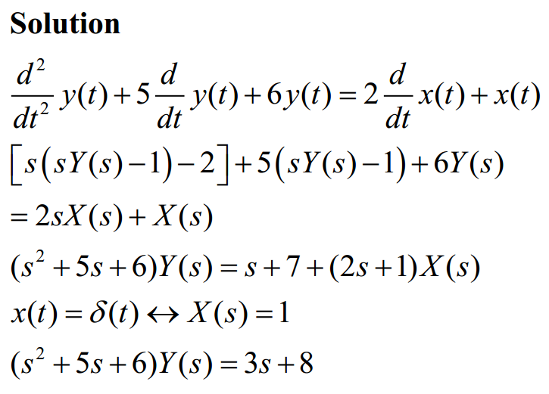
Application of Unilateral LT
zero state: y(0)=0
zero input: x(t)=0

Slide 29
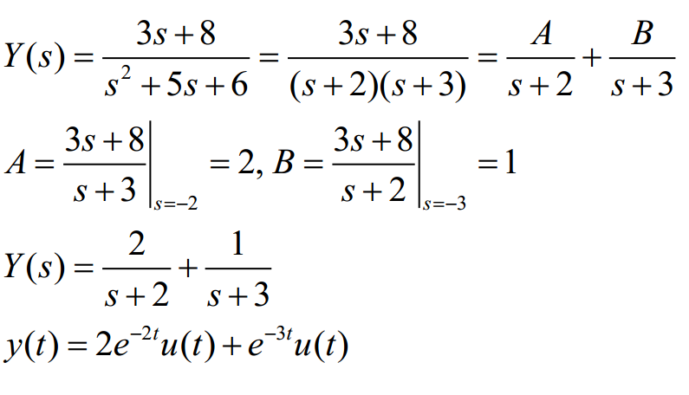
Application of Unilateral LT

